Slide 1
S Club 7
Reach

Slide 2
When the world, leaves you feeling blue

Slide 3
You can count on me, I will be there for you

Slide 4
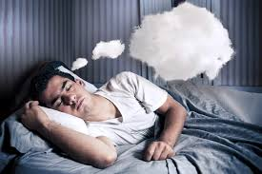
When it seems, all your hopes and dreams

Slide 5
Are a million miles away, I will reassure you

Slide 6
We've got to all stick together

Slide 7
Good friends are there for each other

Slide 8
Never, ever forget that I got you

Slide 9
And you got me so

Slide 10
Reach for the stars

Slide 11
Climb every mountain higher

Slide 12
Reach for the stars

Slide 13
Follow your heart's desire

Slide 14
Reach for the stars

Slide 15
And when that rainbow's shining over you

Slide 16
That's when your dreams will all come true

Slide 17
There's a place, waiting just for you (just for you)

Slide 18
It's a special place, where your dreams all come true

Slide 19
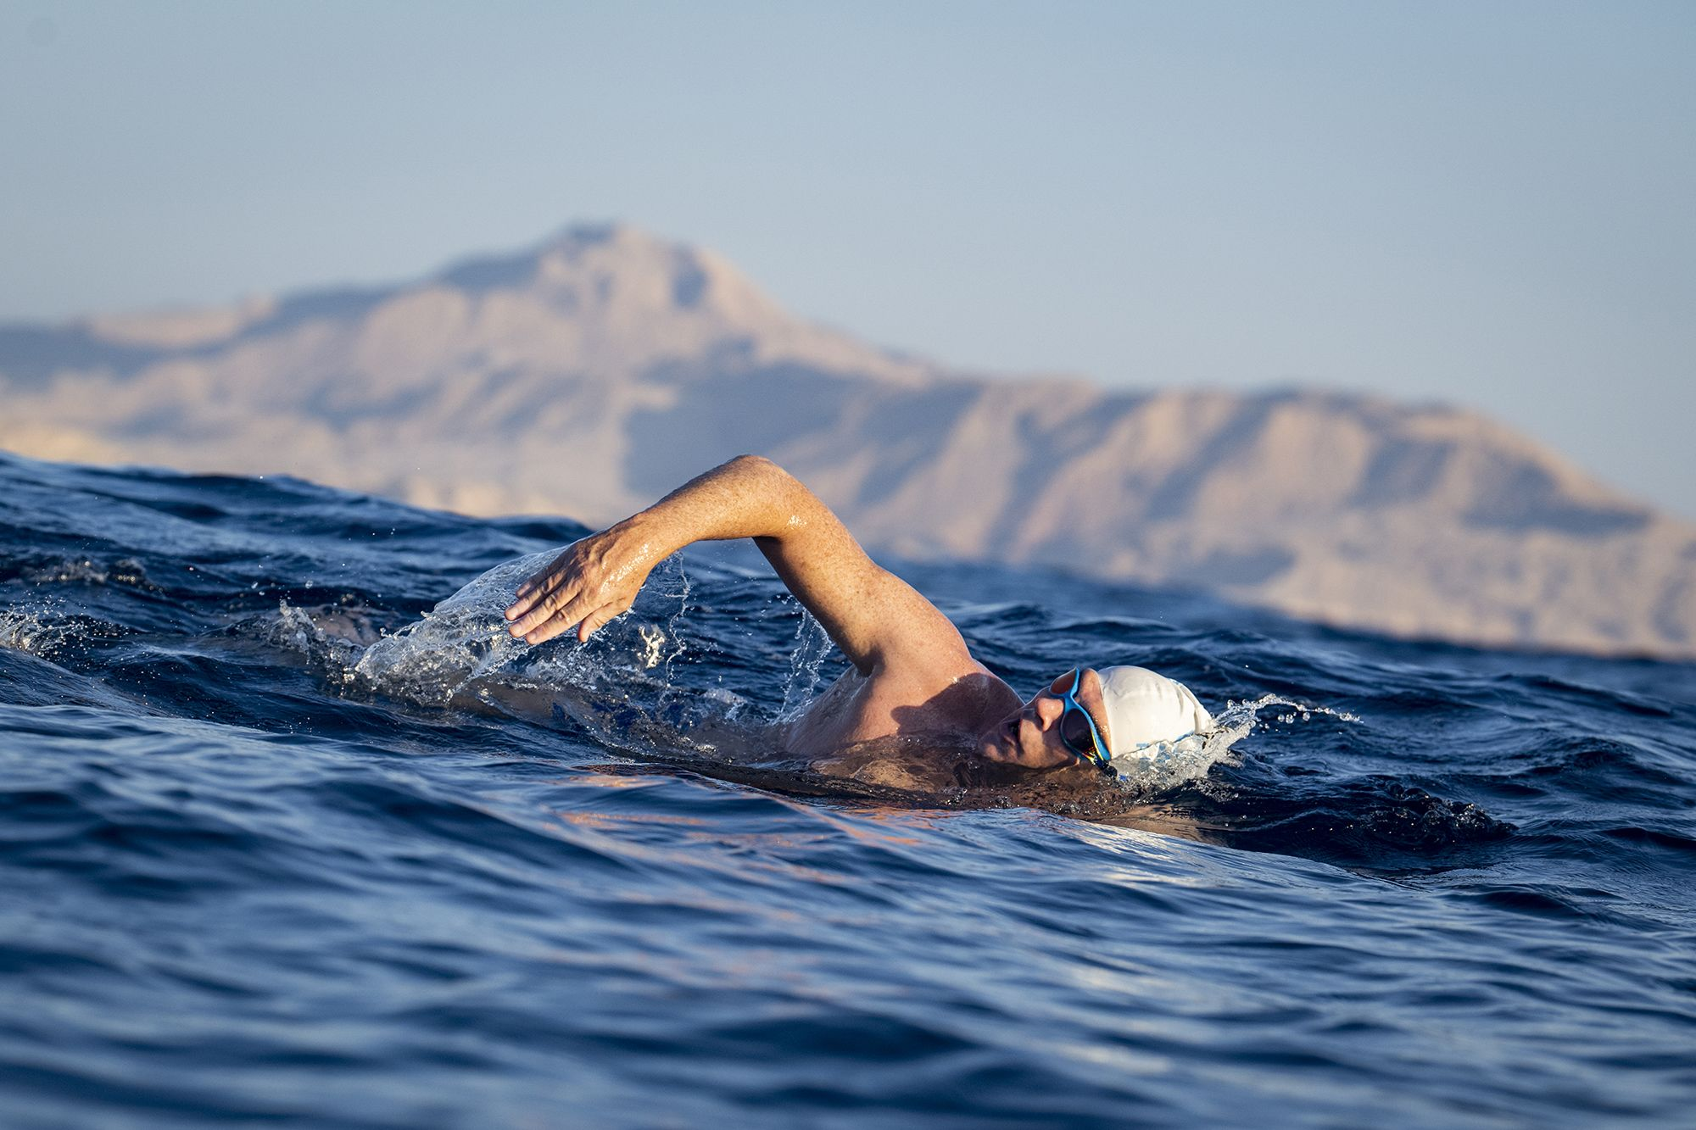
Fly away (fly away), swim the ocean blue (swim the ocean blue)

Slide 20
Drive that open road, leave the past behind you

Slide 21
Don't stop, gotta keep moving

Slide 22
Your hopes have gotta keep building

Slide 23
Never, ever forget that I got you

Slide 24
And you got me so

Slide 25
Reach for the stars

Slide 26
Climb every mountain higher

Slide 27
Reach for the stars

Slide 28
Follow your heart's desire

Slide 29
Reach for the stars

Slide 30
And when that rainbow's shining over you

Slide 31
That's when your dreams will all come true

Slide 32
Don't believe in all that you've been told

Slide 33
The sky's the limit, you can reach your goal

Slide 34
No one knows just what the future holds

Slide 35
There ain't nothing you can't be

Slide 36
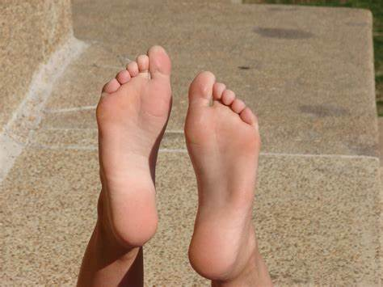
There's a whole world at your feet

Slide 37
I said reach

Slide 38
Climb every mountain

Slide 39
Reach

Slide 40
Reach for the moon

Slide 41
Reach

Slide 42
Follow that rainbow

Slide 43
And your dreams will all come true

Slide 44
Reach for the stars

Slide 45
Climb every mountain higher

Slide 46
Reach for the stars

Slide 47
Follow your heart's desire

Slide 48
Reach for the stars

Slide 49
And when that rainbow's shining over you

Slide 50
That's when your dreams will all come true

Slide 51
Reach for the stars

Slide 52
Climb every mountain higher

Slide 53
Reach for the stars

Slide 54
Follow your heart's desire

Slide 55
Reach for the stars

Slide 56
And when that rainbow's shining over you

Slide 57
That's when your dreams will all come true

Slide 58
Reach for the stars

Slide 59
Climb every mountain higher

Slide 60
Reach for the stars

Slide 61
Follow your heart's desire

Slide 62
Reach for the stars

Slide 63
And when that rainbow's shining over you

Slide 64
That's when your dreams will all come true

